Slide 1
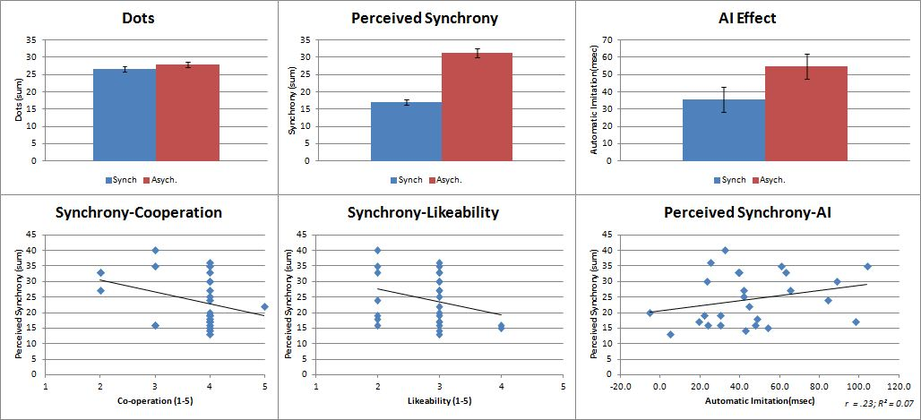


It’s Like Looking in a Mirror
Daniel J. Shaw, Ph.D. ^{1,2} & Kristína Czekóová, Ph.D. ^{1,2}
¹Laboratory for Experimental Research of Religion (LEVYNA), Masaryk University
²Central European Institute of Technology (CEITEC), Masaryk University
Aim: To investigate whether the putative human mirror neuron system (pMNS) is a mechanism through which motor synchrony leads to prosocial behaviour.
    Methods: Compare automatic imitation (AI; a behavioural index of pMNS functioning [Heyes, 2011]) after a period of synchronous or asynchronous motor performance. To ensure equivalent attention to both stimuli types, participants are required to count dots appearing on the actor’s hand.
    (A)Synchrony Automatic Imitation
Preliminary Results: Perceived synchrony is greater in the synchrony (2.5) than the asynchrony condition (4.7; t_{(18.2)}=-9.67, p<.001). There is no effect of synchrony on measures of prosociality, but AI seems to be greater following asynchronous movements (t₍₂₄₎=-1.9, p=.07).
References
Kilner et al., (2007). Cognitive Process., 8, 159
Heyes, C. (2011) Psychological Bulletin, 3 (137), 463

