Slide 1
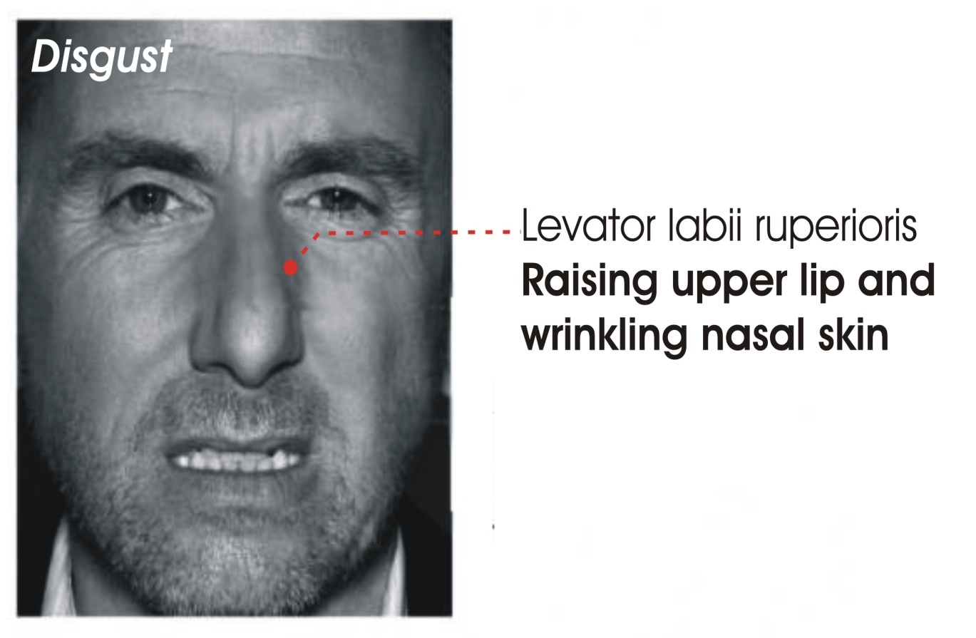
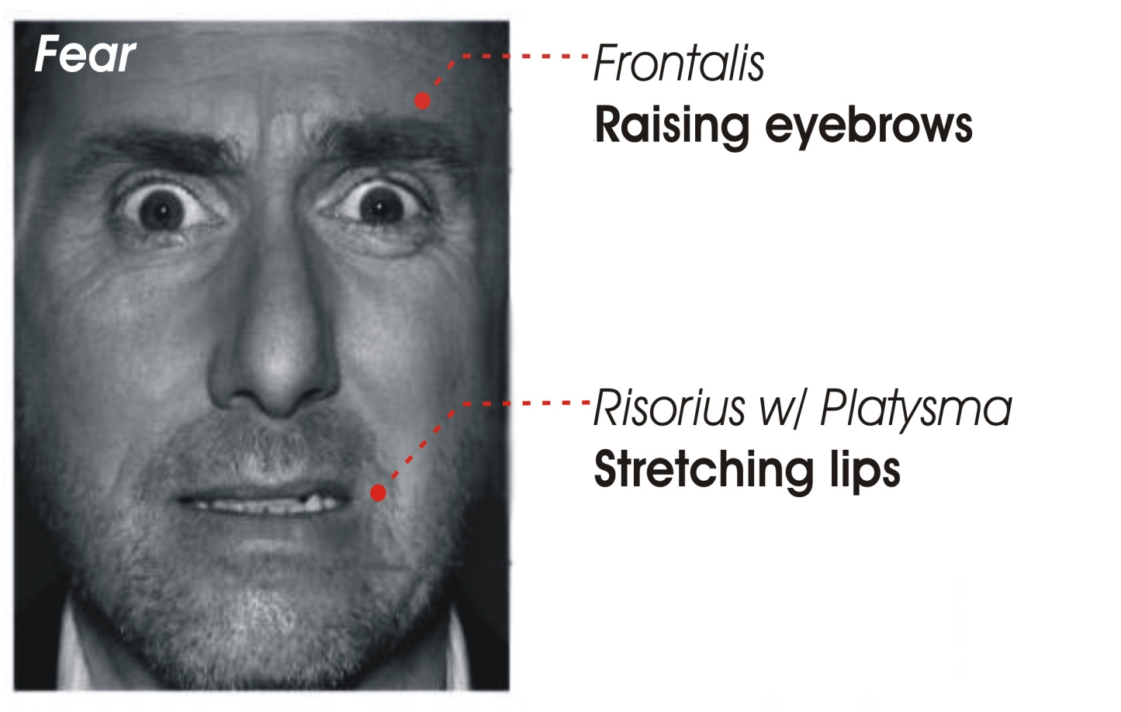
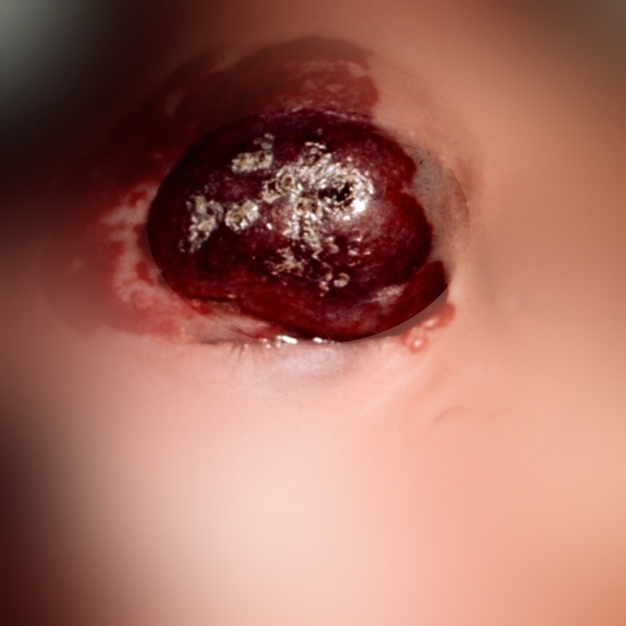
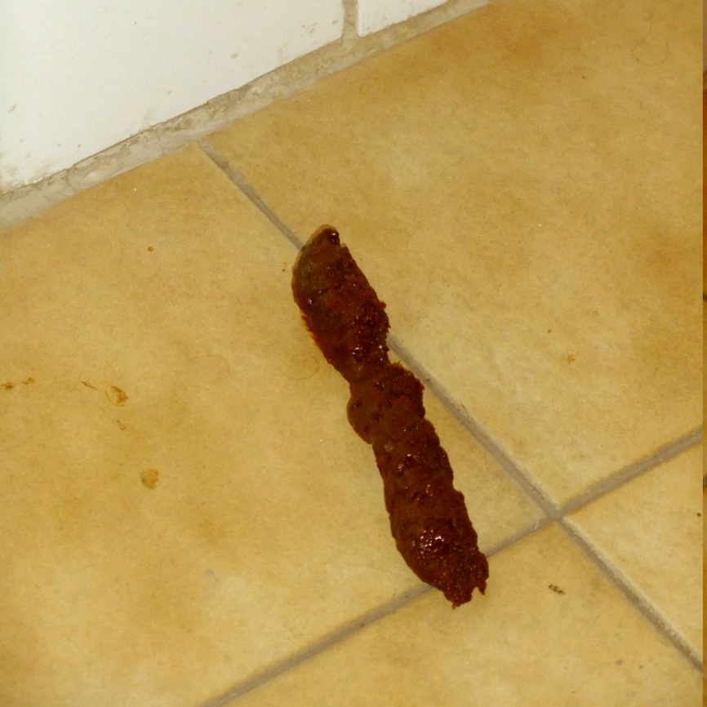
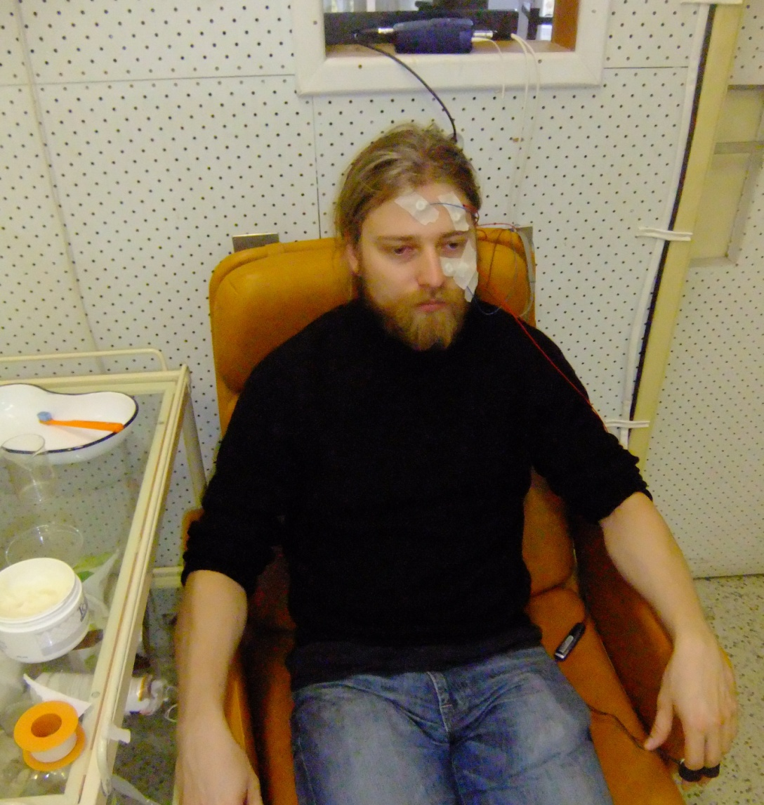
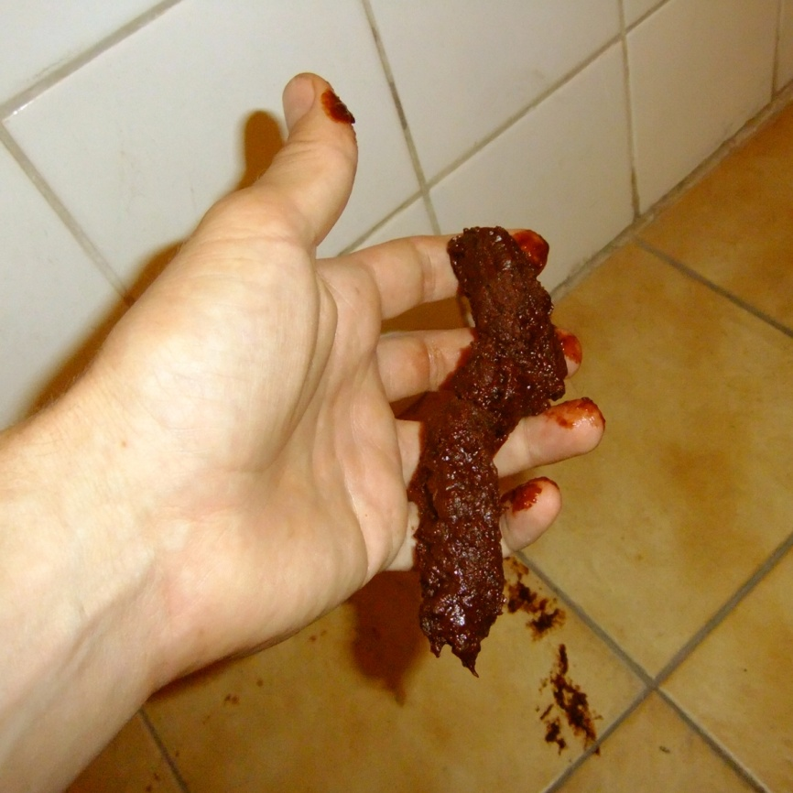
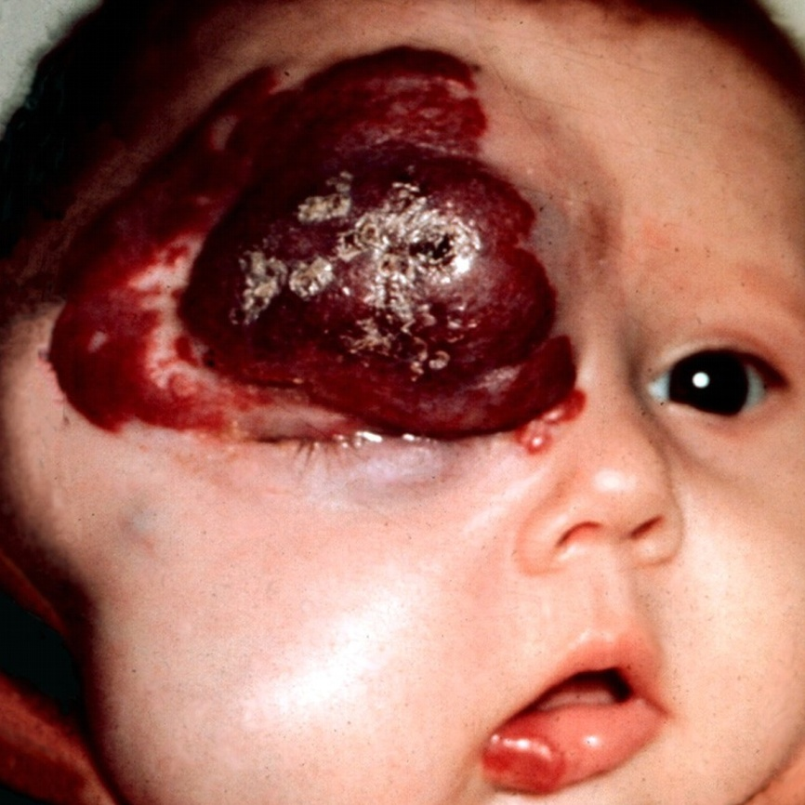
Background
This project is related to religious practices and rituals, which involve objects and situations, which are in certain occasions considered as disgusting (dead bodies, blood, body products, body envelope violations etc.). The normal response typical for disgust is aversion and avoidance, but opposite to these responses some rituals involve touching, kissing, eating or other forms of contact with these stimuli. It seems that these ritualized behaviors go against human intuitions about possible contagion. This specific type of behavior contradicts the evolutionary adaptive – disease/contagion avoiding – function of disgust.
Psychologists suggest that there is a strong and not well understood overlap or interaction between disgust and fear. Disgust elicitors can and often are perceived as threats, and so are highly relevant to fear-triggering. The purpose of this project is based upon this relationship between fear and disgust, to illuminate specific affective state in above mentioned type of rituals. The goal is to explain mechanisms of disgust and fear co-triggering. Such a clarification would enable better interpretations of ritualized behaviors which involve contact with disgusting objects.
Hypothesis
The assumption is that fear is triggered together with disgust in people cannot avoid the contact, or cannot guarantee the non-contact with disgusting objects. This can be the case at least in two situations: (1) the disgusting object can act towards the subject; (2) or the subject is forced to act towards the disgusting object. At this moment, the project deals with the fist option and the hypothesis is as follows:
When a disgusting object activates agency detection, also fear will be triggered.
Procedure
A sequence of pictures will be presented to participants. The sequence will include four picture categories (1) Ten pictures of disgusting objects, (2) ten pictures of the same disgusting object with human morphological cues (hands and faces), (3) ten neutral pictures, and (4) twenty heterogeneous pictures. An increase of fear related physiological changes is expected in (2) comparing to (1). Specific physiological changes typical for disgust and fear represent the dependent variable. The absence/presence of agency in (1) and (2), by means of human morphological cues (e.g. fecal matter – fecal matter held by a human) represent the independent variable.
Measurements
1. The activity of specific face muscles linked distinctively to specific fear and disgust face expression will be measured by using electromyography: frontalis & risorius for fear, and levator labii superioris for disgust.
2. Electrocardiograph measurement of heart rate will be collected. Heat rate increase is typical for fear, and decrease for disgust.
3. Skin conductance response which positively correlates with fear will be measured.
Online survey
The experiment is accompanied by an online survey where a sequence of vignettes, which describe different situations, is presented to participants. There are three variants of each situation, where (1) a disgusting object, (2) an agent, or (3) both are present (e.g. a lift with vomit, a lift with another person, or a lift with a person with vomited clothes). Participants should imagine themselves in described situations and mark how they would feel, by using five Likert scales; one for each basic emotion. Following the hypothesis an increase of fear in the disgust & agent comparing to the disgust vignettes is expected.
References
van Boxtel, A. (2010). Facial EMG as a Tool for Inferring Affective States. In A.J. Spink, F. Grieco, O.E. Krips, L.W.S. Loijens, L.P.J.J. Noldus, and P.H. Zimmerman (Eds.) Proceedings of Measuring Behavior, 104 – 108.
de Jong, P.J., Overveld, M. & Peters, M.L. (2011). Sympathetic and parasympathetic responses to a core disgust as a function of disgust propensity and disgust sensitivity. Biological Psychology 88, 174–179.
Stark, R., Walter, B., Schienle, A., & Vaitl, D. (2005). Psychophysiological Correlates of Disgust and Disgust Sensitivity. Journal of Psychophysiology, Vol 19(1), 50-60.
Vrana, S.R. (1993). The psychophysiology of disgust: Differentiating negative emotional contexts with facial EMG. Psychophysiology, Vol. 30, Issue 3, 279–286.
Woody, S.R. & Teachman B.A. (2000) Intersection of Disgust and Fear: Normative and Pathological Views. Clinical psychology: science and practice 7, 291–311

