Slide 1




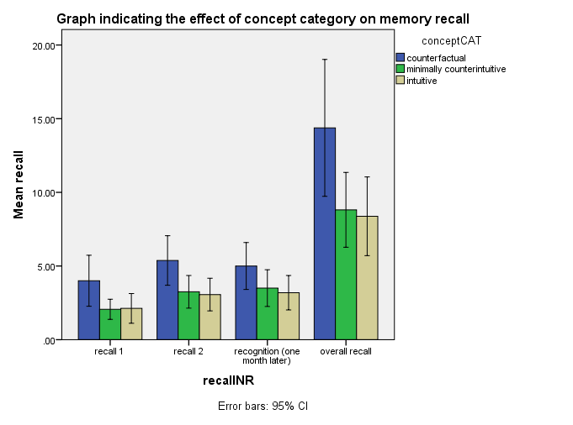
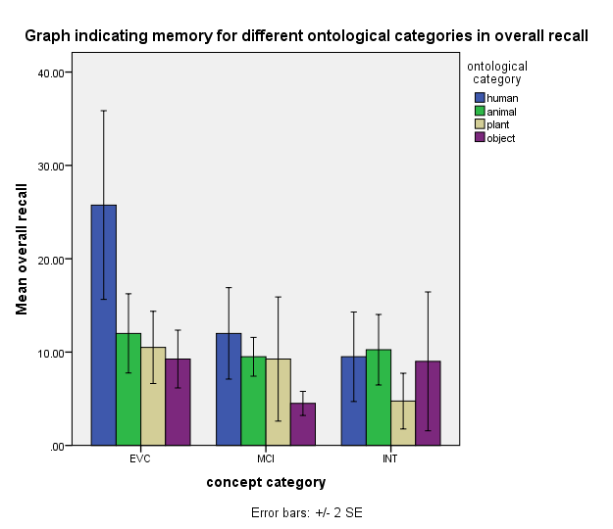
What´s so special about minimally counter-intuitive concepts?
Porubanova, M.¹, Xylagatas, D.¹, Shaw, D.J.¹, & McKay, R.²
¹LEVYNA, Masaryk University, Brno, Czech Republic
²Royal Holloway , University of London, UK
Introduction
Minimally counter-intuitive concepts (MCI) have been a focus of research in cognitive science of religion due to the their capacity to attract attention and be memorable. Those mechanisms are deemed to underlay the spread of religious beliefs, which are frequently also counter-intuitive. However, research focused on the memorability of MCI has provided rather contradictory results. Our study concerned resolving the issue of the memorability of MCI concepts while controlling for confounding variables (i.e., word length, word frequency, processing time). The following concept categories were included: 1, intuitive e.g., galloping pony; 2, minimally counterintuitive e.g., worried chair; and 3, counterfactual (violating cultural expectations) e.g., illiterate teacher. Furthermore, ontological categories were taken into account, i.e., human, animal, plant and object.
The research questions were as follows:
Are minimally counterintuitive concepts more memorable than other concepts?
Are there concepts more easily learned than others due to repeated exposure to them?
Are there ontological categories which are recalled better?
Method
Simple recall paradigm
25 subjects
participants studied 48 concepts (4 in each concept category and ontol. category)
SOA=1500ms
Learning phase 1, Distractor Task (2 min), Recall phase 1
Learning phase 2, Distractor Task (2 min), Recall phase 2
Recognition task (approx. 1 month after completion of the study)
Results
A one-way analysis of variance was conducted in order to determine the effect of concept category on memory recall.
RECALL 1: F(2,45)= 3.69, p<.05, ω= .38
The memorability of counter-factual concepts (M= 4.00, SD= 3.25) was superior to that of MCI (M= 2.06, SD=1.29) and intuitive (M=2.12, SD=2.42) concepts. The recall of MCI concepts is not significantly different from the recall of intuitive concepts at p<.05.
RECALL 2: F(2,45)= 4.25, p<.05, ω= .47
The recall of EVC concepts was greater (M= 5.39, SD= 3.16) than that of MCI (M= 3.25, SD=2.08) or INT concepts (M=3.06, SD=2.08). Again, the recall of INT and MCI concepts was not significantly different at p< .05.
RECOGNITION (1 MONTH LATER): F(2,45)= 2.43, ns
No significant effect of concepts category on memory recognition was found.
OVERALL RECALL: F(2,45)=179.05, p<.05, ω= .17
The recall of EVC concepts was greater (M= 14.38, SD= 8.71) than that of MCI (M= 8.81, SD=4.76) or INT concepts (M=8.37, SD=5.02). Again, the recall of INT and MCI concepts was not significantly different at p< .05.
Examples of concepts used: blind driver (counterfactual); speaking cat (MCI), and drinking dog (intuitive)
Conclusion
Using a simple recall paradigm, we did not find minimally counter-intuitive concepts to be more memorable than intuitive concepts. However, counterfactual concepts were found to be the most memorable across all recalls. It can be concluded that if MCI concepts are included in a mix with concepts that violate our cultural expectations their memorability is rather diminished.

