Slide 1

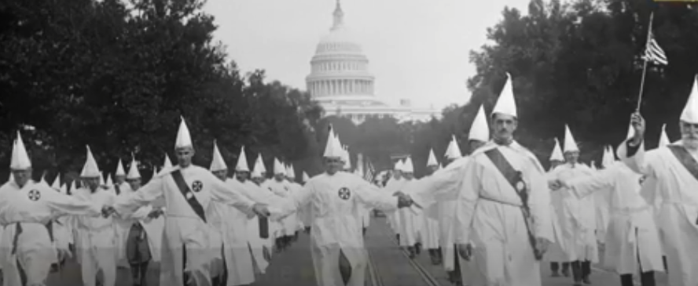
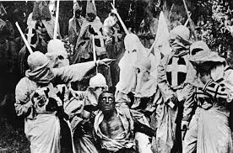
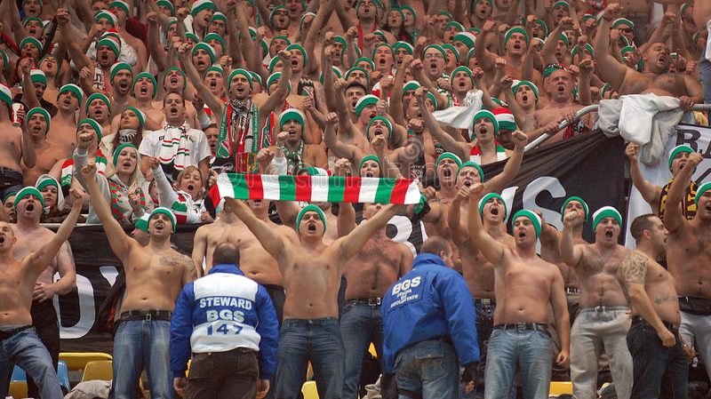
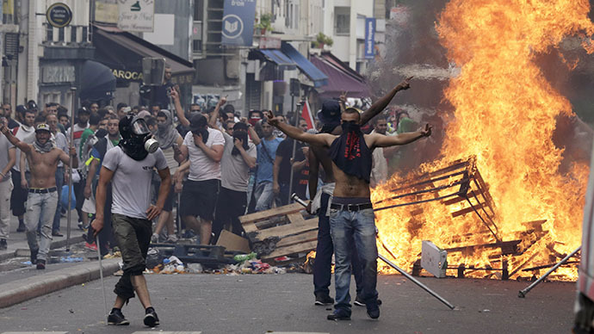









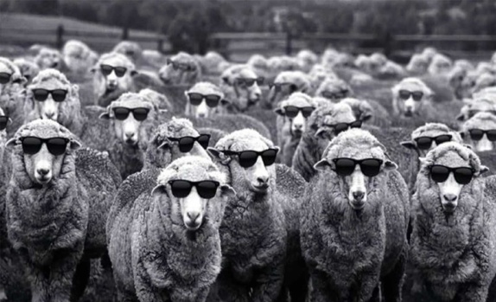


Synchrony and Moral Hypocrisy
Radim Chvaja^{1,2}, Radek Kundt¹
1 – LEVYNA (Laboratory for Experimental Research of Religion, Brno)
2 – contact: radimchvaja@gmail.com
INTRODUCTION
Intergroup aggression (e.g., political demonstrations or sports fan violence) often involves some degree of interpersonal motoric or vocal synchrony, namely choral chanting of slogans, choir singing of pre-learned songs, choral motor gestures or choral rhythmic hopping. At the same time, these activities exhibit the features of rigidity, repetition and redundancy, which we usually use as defining observable signs of religious or secular ritual behavior. On the one hand, it is obvious that not all participants take direct violent action. On the other hand, they do little to stop these acts. The reason could be the fear of aggressors or their authority. However, is there any other possible factor?
MORAL HYPOCRISY
DEPENDENT VARIABLE
INDEPENDENT VARIABLE
People judge the same transgression less harshly when committed by themselves or in-group members than by others (Valdesolo & Desteno 2007) and punish the out-group members more (Jordan et al. 2014).
Moral judgement of transgression against fairness done by coordination partner from previous task:
Level of synchrony:
1) SYNCHRONY
2) ASYNCHRONY
3) CONTROL (without coordination)
          Feedback task (Valdesolo & Desteno 2007):
          „We test a new application that assigns participants to the conditions.“ Participant is asked to provide us with his feedback. Participant watches his coordination partner during his path through procedure via „yoked computers“.
In one moment, the partner cheats the application and chooses a simpler task while the difficult and time consuming task leaves for the next participant. Feedback questionnaire then contain question: „How fairly did participant act?“ 1 – 9
+
Participant performs simple movements through „live“ broadcast with another participant who is, in fact, our assistant in pre-recorded video (Lang et al. 2017).
SYNCHRONY EFFECT
Cooperation
(Wiltermuth & Heat 2009)
Conformity
(Wiltermuth 2012)
Synchrony
HYPOTHESIS
Sympathy
(Launay et al. 2014)
More lenient judgements
We predict that participants in SYNC condition will judge the transgression more leniently.
Synchrony – when people perform the same movements in the same time, rhythm and phase.
We will keep all agents in experiment under the same identity in order to distinguish synchrony effect from identity effect.
RESEARCH QUESTION
?
Moral
hypocrisy
CITED LITERATURE
Jordan, J. J., Mcauliffe, K., & Warneken, F. (2014). Development of in-group favoritism in childrens third-party punishment of selfishness. Proceedings of the National Academy of Sciences, 111(35), 12710-12715.
Lang, M., Bahna, V., Shaver, J. H., Reddish, P., & Xygalatas, D. (2017). Sync to link: Endorphin-mediated synchrony effects on cooperation. Biological Psychology, 127191-197.
Launay, J., Dean, R. T., & Bailes, F. (2014). Synchronising movements with the sounds of a virtual partner enhances partner likeability. Cognitive Processing, 15(4), 491-501
Valdesolo, P., & DeSteno, D. (2007). Moral Hypocrisy: Social Groups and the Flexibility of Virtue. Psychological Science, (8). 689-690.
Wiltermuth, S. (2012). Synchrony and destructive obedience. Social Influence, 7(2), 78-89. doi:10.1080/15534510.2012.658653
Wiltermuth, S. S., & Heath, C. (2009). Synchrony and Cooperation. Psychological Science (0956-7976), 20(1), 1-5.
Could be synchrony one of factors affecting moral judgements?

